Slide 1
Introduction to Time Series Data
Linden Lu

Slide 2
Time Series Data
Working with dates and times
Analyzing time series data

Slide 3
Working with Dates and Times
Linden Lu

Slide 4
Date Time Related Modules
Time
datetime
datetime
timedelta

Slide 5
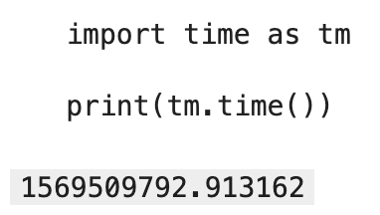
Time Module
Epoch: 1/1/1970(UTC)
timestamp

Slide 6
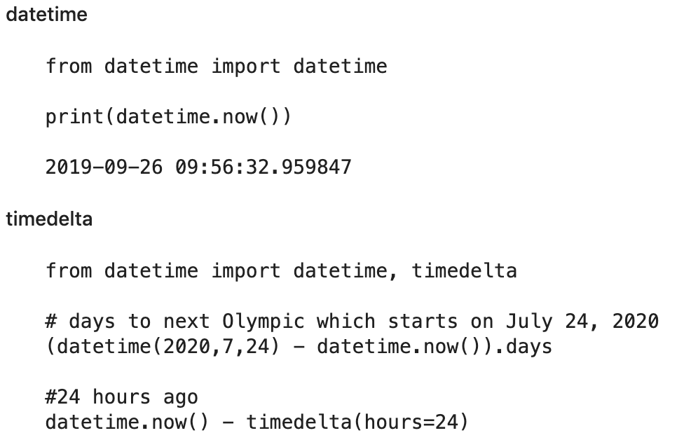
datetime

Slide 7
datetime Format
%m: Month as a zero-padded number, i.e. “09”
%d: Day of the month as a zero-padded number, i.e. “30”
%Y: Year with century as a number, i.e. ”2019”
%b: Month as locale’s abbreviated name, i.e. “Sep”
%H: Hour (24-hour clock), i.e. “23”
%M: Minute as a zero-padded number, i.e. “59”
%S: Second as a zero-padded number, i.e. “59”

Slide 8
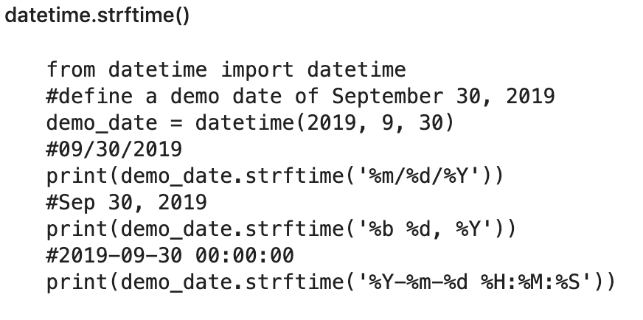
datetime to String

Slide 9
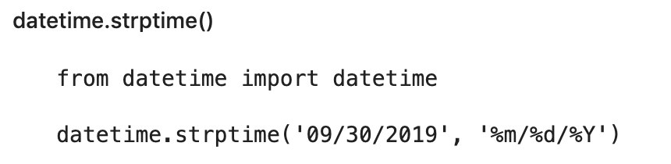
String to datetime

Slide 10

DataFrame datetime Manipulation

Slide 11
Analyzing Time Series Data
Linden Lu

Slide 12
Time Series Data
A series of data points indexed in time order
Normally with equal intervals between indexes
Examples
Daily Dow Jones Index Close
Hourly Weather Data

Slide 13
Data – Beijing Environment
 | year | month | day | hour | pm2.5 | TEMP
8910 | 2011 | 1 | 7 | 6 | 23.0 | -11.0
13486 | 2011 | 7 | 16 | 22 | 37.0 | 24.0
4183 | 2010 | 6 | 24 | 7 | 109.0 | 23.0
28966 | 2013 | 4 | 21 | 22 | 89.0 | 13.0
25107 | 2012 | 11 | 12 | 3 | 13.0 | 2.0

Slide 14
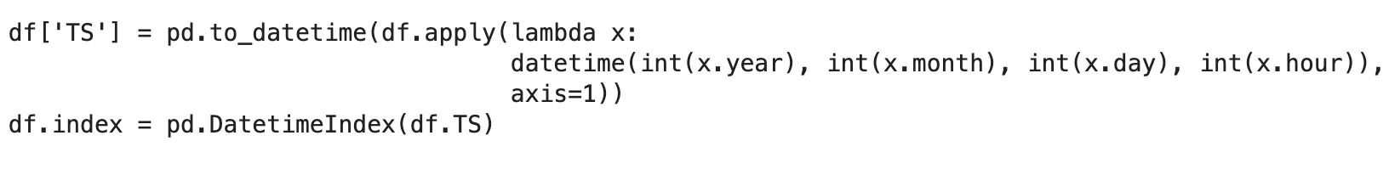
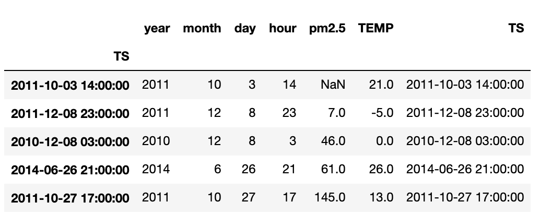
Create Time Index

Slide 15
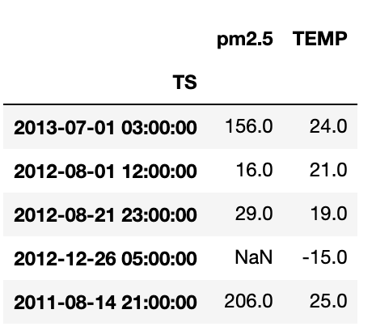
Create Time Index

Slide 16

Handling Missing Values

Slide 17
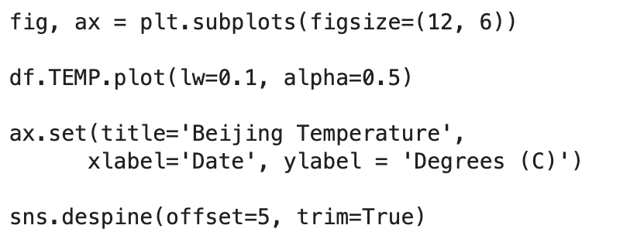
Plot Time Series Data

Slide 18
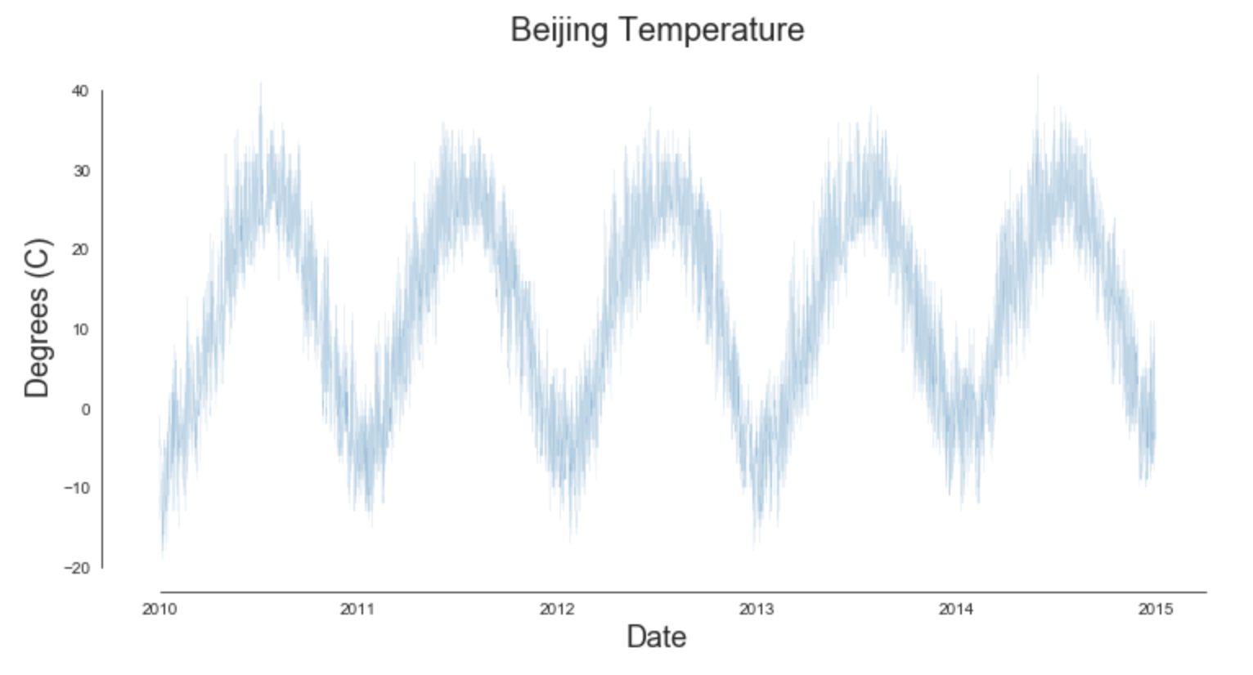
Plot Time Series Data

Slide 19
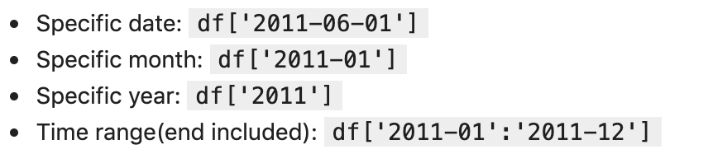
Time Series Data Slicing

Slide 20
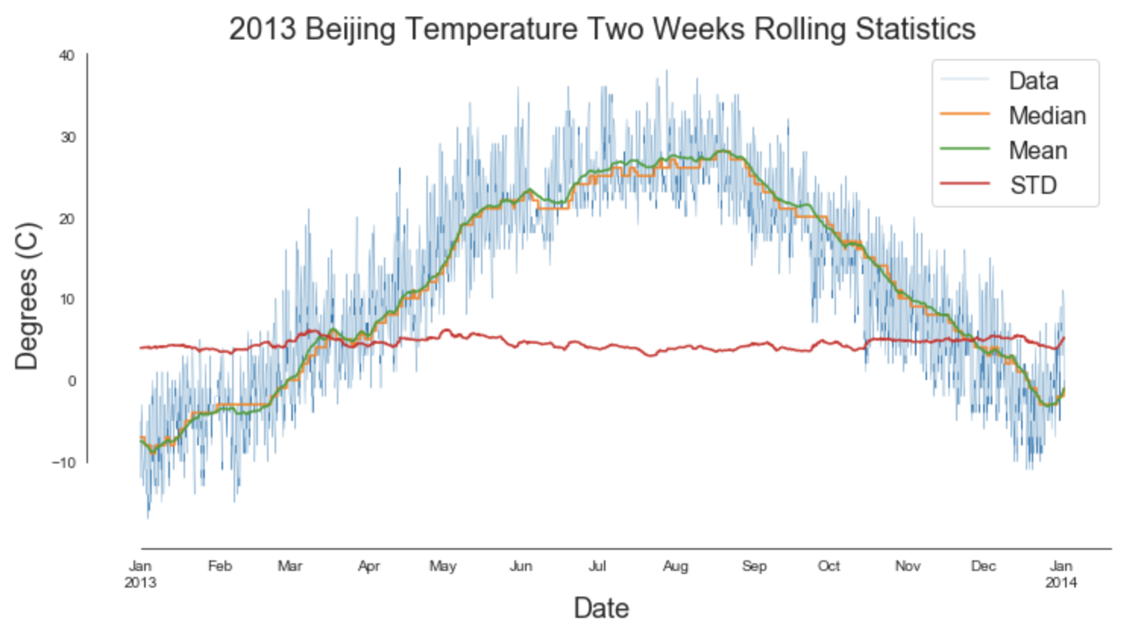
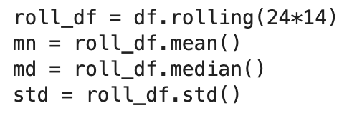
Rolling Statistics

Slide 21
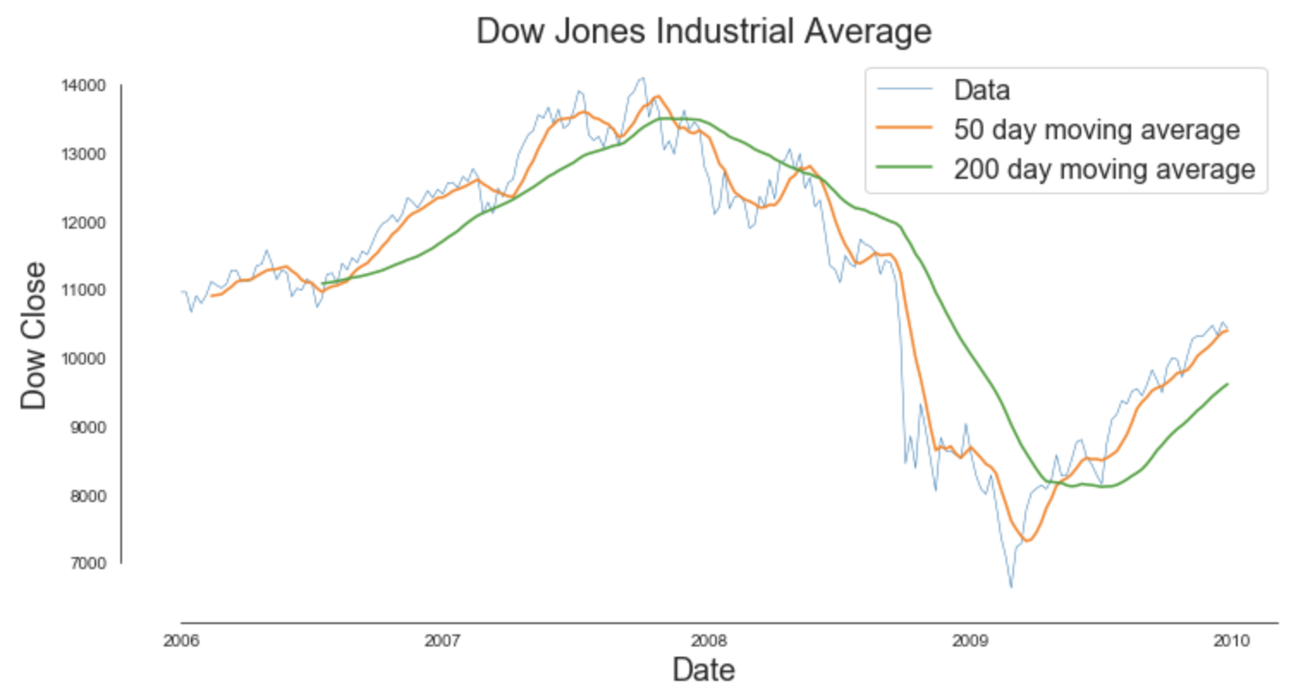
Death Cross

Slide 22
Resampling
B: business day frequency
D: calendar day frequency
W: weekly frequency
M: month end frequency
BM: business month end frequency
MS: month start frequency
BMS: business month start frequency

Slide 23
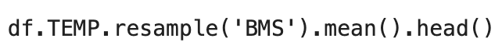
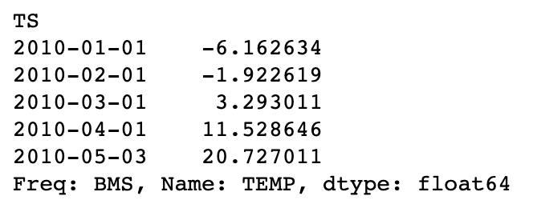
Resampling

Slide 24
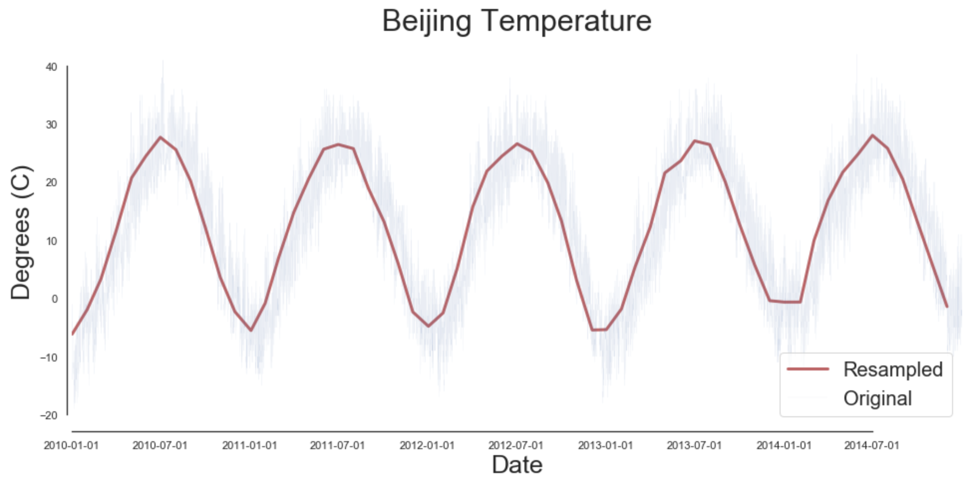
Resampling

Slide 25
Seasonal Decomposition
Level: The average value in the series
Trend: The underlying trend in the series
Seasonality: The repeating short-term cycle in the series
Noise: The random variation in the series, a.k.a. residual

Slide 26
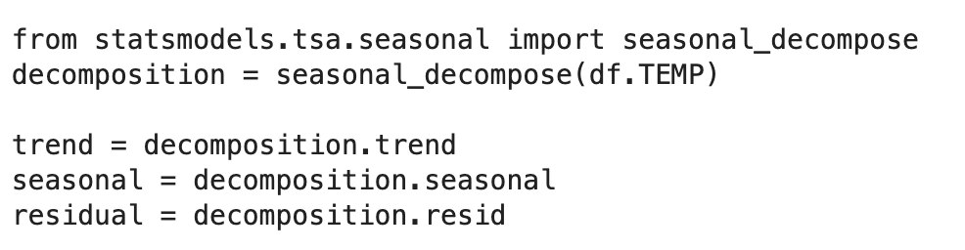
Seasonal Decomposition

Slide 27
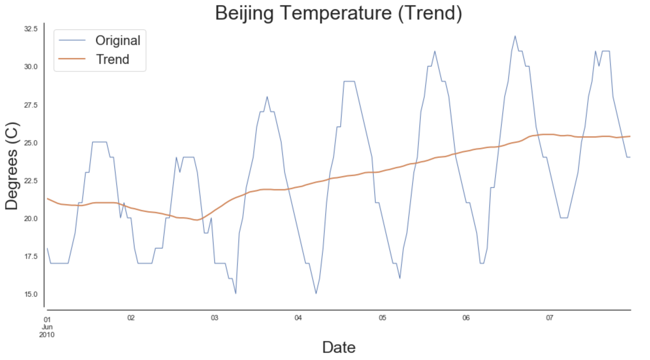
Seasonal Decomposition
Trend

Slide 28
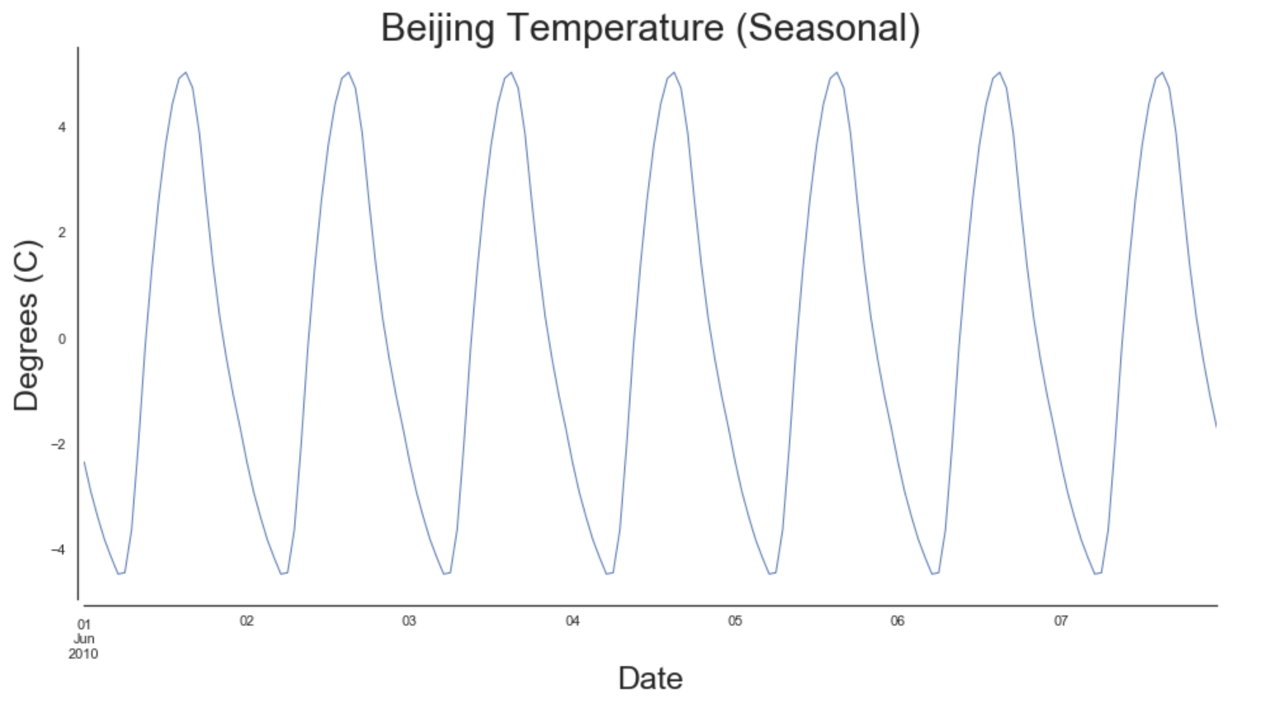
Seasonal Decomposition
Seasonality

